Slide 1



Customer Satisfaction on Software Projects

Slide 2
Importance of Customer Satisfaction in Software Projects
The least focused metrics in Project Management is Customer Satisfaction.
In this digital disruption age and increasing competition, most of the companies rush to complete the project at any cost. Even though you complete a project on time and cost, but customer satisfaction isn’t guaranteed.
Then what is customer satisfaction?

Slide 3
Importance of Customer Satisfaction in Software Projects
Customer Satisfaction is a measure of your customer’s satisfaction with your product, services or experience offered by you.
Customer Satisfaction measures how your service, product, or support meets, exceeds or falls short of customer expectations.
At the end, product and services that meet customer’s needs, will be considered as result, but the experiences you have and behaviors you act during project life cycle will affect the result.

Slide 4
Importance of Customer Satisfaction in Software Projects
Good Experience = Probable Prospects
Probable Prospects = Converted to Customers
Good Support or Service = Customer Satisfaction
Customer Satisfaction = More Retention
More Retention = Increasing Customer Base
Increasing Customer Base = More Profits/revenue

Slide 5
Benefits of Customer Satisfaction
Brand Loyalty: Most happy or satisfied customers chose to stay with their brands or service providers. That means less churning, high retention & higher brand loyalty.
Brand Buzz: Your happy customers will leave positive reviews on the company project is hosted. That’s free publicity you can’t get with paid ads.
Brand Trust: Your brand’s reviews or recommendations from your satisfied customers will make your brand more trusted than others.
Happy Employees: At the end, customer satisfaction means not only more revenue or customer retention, but also you’ll see employees will be happy too.

Slide 6
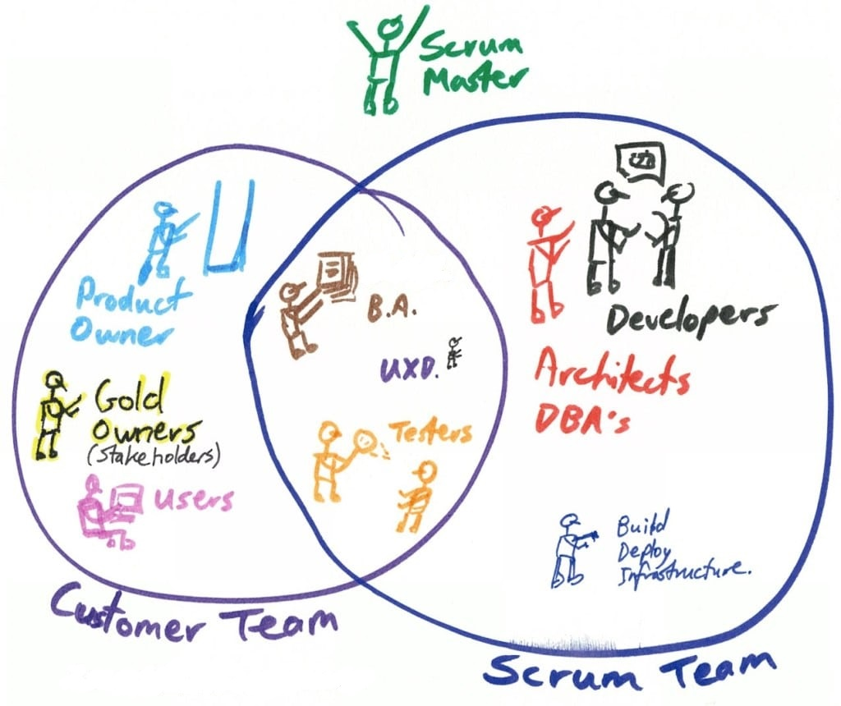
How to Keep Your Customers Happy During Projects

Slide 7
How to Keep Your Customers Happy During Projects
Make them a part of the Team
If you consider your customers as outsiders, then you tend to hide the actual truth from them. Consider them as a part of the team that will help build trust and confidence on your product or service.
Update the Progress
Most team are occupied with project completion and overlook stakeholders’ expectations. Thus they tend to miss out on sharing the right info to the right audience at the right time. Understanding your audience and sharing relevant project information is key.
It is better to be transparent and truthful. Irrespective of your projects, if you share a logical view of the issue or situation at hand it becomes easier for you to get the customer’s help required; be it resources, funding or time.

Slide 8
How to Keep Your Customers Happy During Projects
Ensures No Communication Gap
When everything is open and available to customers, there will be no communication gap.
And most of the time, your customers may miss the analysis interviews or the email and document and then the communication gap starts. There may be no logs to see what happened previously or what the status was?
So, make the customers up-to-date with all information in a nice way that feels them important

Slide 9
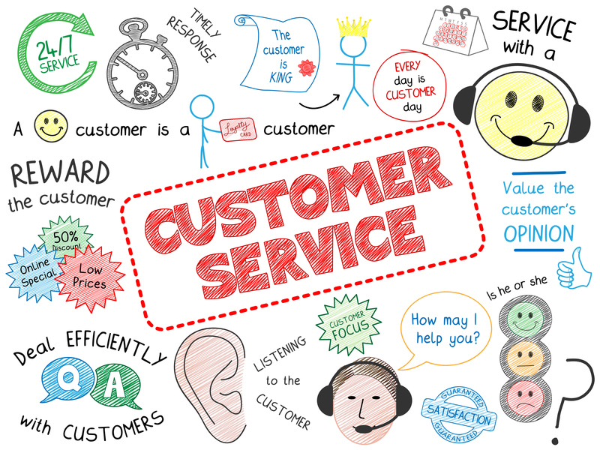
How to Keep Your Customers Happy During Projects
Face-to-face conversation is the best form of communication
Questions are answered faster in person rather than through email. This is another benefit of co-habitation. Face-to-face interaction allows problems to be solved with greater efficiency.

Slide 10
The "Yes But" Syndrome
A friend asks you for advice about a problem she's having, and every suggestion or idea you offer is met with "Yes, but that won't work for me because . . . "
You've had the experience? I'm sure you have. I think we all have.
Sometimes it happens in a one on one situation with a friend or colleague, and sometimes in a bigger arena like at a meeting at work where there is a brainstorming session to help solve a problem, and the suggestions are shut down as fast as they come up.

Slide 11
The "Yes But" Syndrome
The "yes but" syndrome is fear in disguise.
Fear of stepping out of your comfort zone,
Fear of trying something new or different,
Fear that the problem won't be solved and so you prevent it from being solved, or fear of success in some cases.

Slide 12
How To Handle It On Behalf Of Customer?
In so doing, we elicit the "Yes, But" response early, and we then can begin to invest the majority of our development efforts in software that has already passed the "Yes, But" test.

Slide 13
Listening doesn't mean agreement
Hearing new ideas doesn't mean that you have to accept or use them. It just means that they are possibilities that could be helpful. Just take them and add them to the list of possibilities. No further action is required until and unless you decide to act on any of them.

Slide 14
Have an open mind
In most cases, there is more than one solution to a problem or more than one way to look at something. Open yourself up to hearing as many possible ideas or solutions as you can without making immediate judgment on what will work. Avoid censoring.
Your goal should be to hear as many possibilities and solutions as you can and just list them in your head, or on paper, for future consideration. You're not making decisions right now.

Slide 15
Allow time for decisions
When you hear new ideas or someone offers a solution to a problem that seems kind of "out there," the default reaction is to dismiss it. This is a mistake.
Sometimes those ideas end up being the best solutions. Take everything in and then let it sit. Our minds can work wonders if we allow the time necessary for all of the connections and patterns to come together to give us answers.
You know how sometimes you struggle with a problem and then you sleep on it, and the answer appears in the morning? That's because the subconscious is working for you and connecting the dots you couldn't see initially. Allow time if you can before making snap decisions.

Slide 16
Check your fear at the door
Fear is our worst enemy. It can be subtle. If you have a problem that feels urgent, you can become afraid that no solution will appear, and so you shut down any possibility without real consideration.
You may also be afraid of branching out and trying something new. Actually, this occurs a lot.
People love their comfort zones, even if they are constricting or dysfunctional. Ask yourself if fear is keeping you from hearing or trying different solutions that could be effective for you.

Slide 17
How Do We Measure Satisfaction?
These question is not easy to answer, but thankfully there’s a very useful tool to guide us through them: the Kano Model.

Slide 18
Kano Model
Noriaki Kano, a Japanese researcher and consultant, published a paper in 1984 with a set of ideas and techniques that help us determine our customers’ (and prospects’) satisfaction.
These ideas are commonly called the Kano Model and are based upon the following premises:
Customers’ Satisfaction with our product’s features depends on the level of Functionality that is provided (how much or how well they’re implemented);
Features can be classified into four categories;

Slide 19
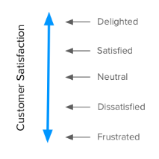
Satisfaction vs Functionality
It all starts with our goal: Satisfaction. Kano proposes a dimension that goes from total satisfaction (also called Delight and Excitement) to total dissatisfaction (or Frustration).

Slide 20
Satisfaction vs Functionality
You might think that you’d always want to be at the top of that scale, right?
It’s not possible.
That’s where the Functionality comes in.
Also called Investment, Sophistication or Implementation, it represents how much of a given feature the customer gets, how well we’ve implemented it, or how much we’ve invested in its development.

Slide 21
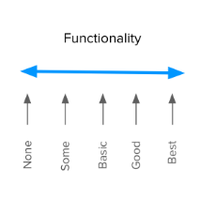
Satisfaction vs Functionality
This dimension goes from no functionality at all, to the best possible implementation. That’s why the term Investment is also very good for this concept. It is clear in reminding us of the cost of doing something.
Naming aside, what’s really important is to know that these two dimensions put together are the basis of the Kano Model and determine how our customers feel about our product’s features.

Slide 22
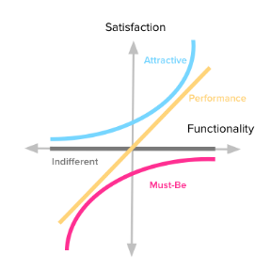
Kano Model: The Four Categories of Features

Slide 23
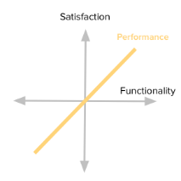
Performance
Some product features behave as what we might intuitively think that Satisfaction works:
The more we provide, the more satisfied our customers become. Because of this proportional relation between Functionality and Satisfaction, these features are usually called Linear, Performance or One-Dimensional attributes in the Kano literature
When you’re buying a car, its gas mileage is usually a Performance attribute. Other examples might be your internet connection speed; laptop battery life; or the storage space in your Dropbox account. The more you have of each of those, the greater your satisfaction.

Slide 24
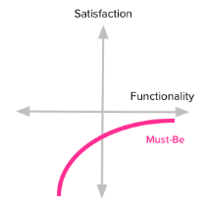
Must-be
Other product features are simply expected by customers. If the product doesn’t have them, it will be considered to be incomplete or just plain bad. This type of features is usually called Must-be or Basic Expectations.
Here’s the deal with these features: we need to have them, but that won’t make our customers more satisfied. They just won’t be dissatisfied.
We expect our phones to be able to make calls. Our hotel room should have running water and a bed. The car should have brakes. Having any of these won’t make us happy, but lacking them will definitely make us angry towards the product or service.

Slide 25
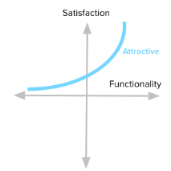
Attractive
There are unexpected features which, when presented, cause a positive reaction. These are usually called Attractive, Exciters or Delighters. I tend to prefer the term Attractive, because it conveys the notion that we’re talking about a scale. We can have reactions ranging from mild attractiveness to absolute delight, and still have everything fit under the “Attractive” name.
The first time we used an iPhone, we were not expecting such a fluid touchscreen interface, and it blew us away. Think of the first time you used Google Maps or Google Docs. You know, that feeling you get when experiencing something beyond what you know and expect from similar products.
Just remember that our brains don’t have to explode for something to fall under this category. It might be anything that makes you go: “Hey, that’s nice!”.

Slide 26
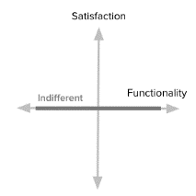
Indifferent
Naturally, there are also features towards which we feel indifferent. Those which their presence (or absence) doesn’t make a real difference in our reaction to the product.
These features fall along the middle of the Satisfaction dimension (where the horizontal axis intersects it.) That means it doesn’t matter how much effort we put into them, users won’t really care. This is another way of saying we should really avoid working on these because they’re essentially money sinks.

Slide 27
TEŞEKKÜRLER

